Slide 1
Merging and Data Cleaning
Lesson 4.3

Slide 2
Class Objectives
By the end of today’s class, you will be able to:
Merge DataFrames and distinguish between inner, outer, left, and right merges.
Slice data by using the cut() method, and create new values based on a series of bins.
Fix Python/Pandas bugs within Jupyter Notebook.
Use Google to explore additional Pandas functionality.

Slide 3
Merging DataFrames

Slide 4
Merging DataFrames
What’s Merging?
Sometimes, an analyst will receive data split across multiple tables and sources.
Working across multiple tables is error-prone and confusing.
Merging is the process of combining two tables based on shared data.
Shared data can be an identical column in both tables or a shared index.
In Pandas, we can merge separate DataFrames by using the pd.merge() method.

Slide 5
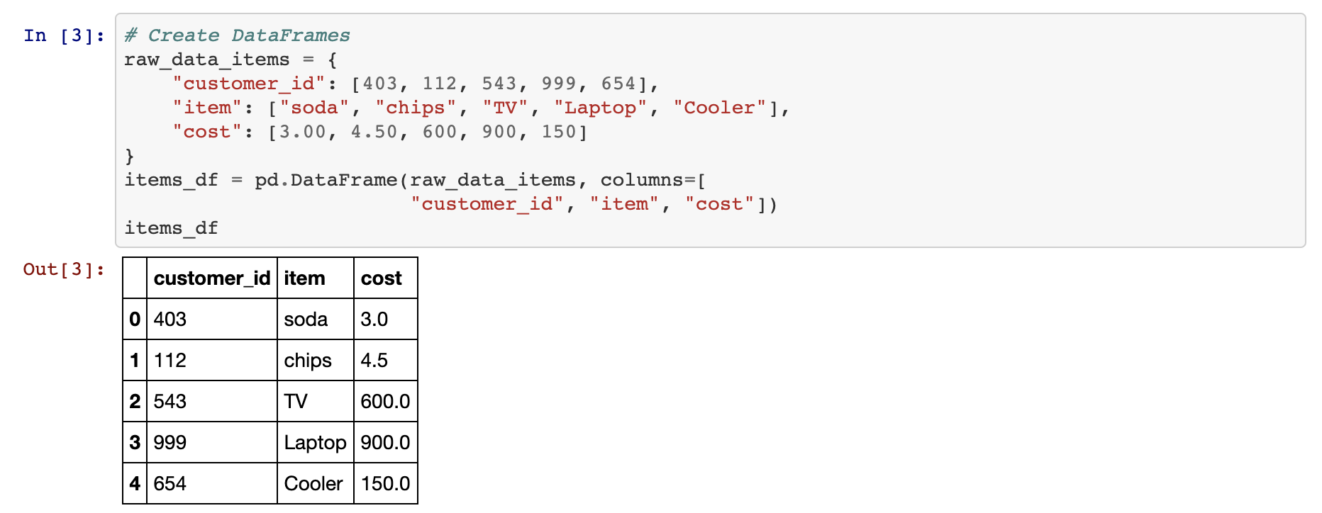
Merging DataFrames: Inner Joins
An inner join is the default method for combining DataFrames by using pd.merge(). It only returns data whose values match. Rows that do not include matching data will be dropped from the combined DataFrame.

Slide 6
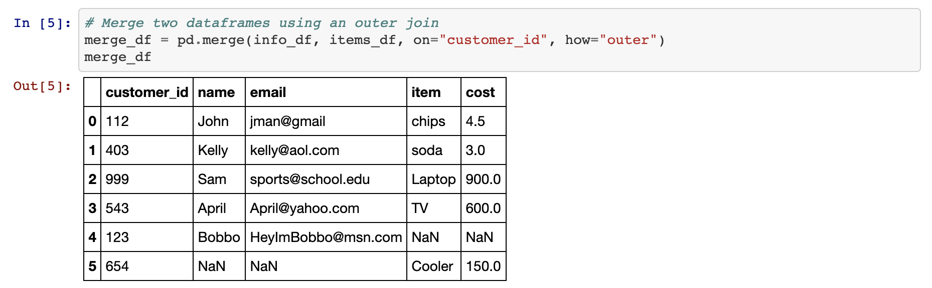
Merging DataFrames: Outer Joins
Outer joins combine the DataFrames whether or not any of the rows match. They must be declared as a parameter within the pd.merge() method by using the syntax how="outer".

Slide 7
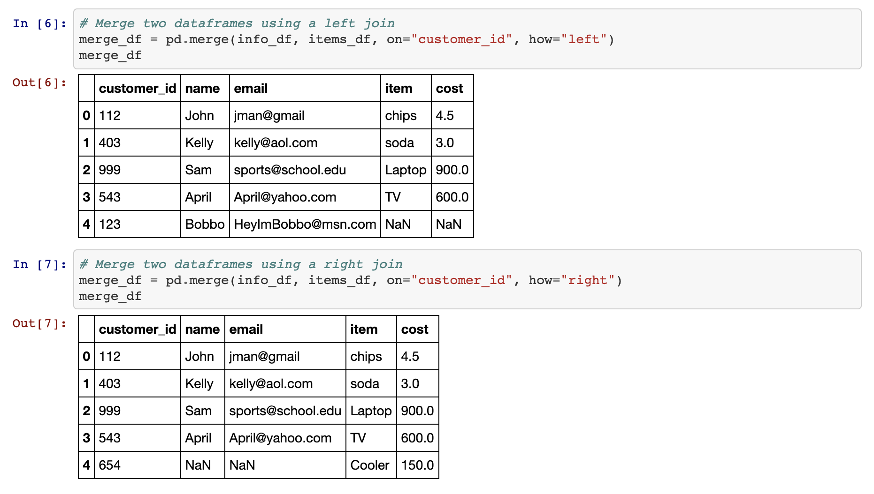
Merging DataFrames: Right and Left Joins
These joins protect the data contained within one DataFrame, like an outer join does, while also dropping the rows with null data from the other DataFrame.

Slide 8
Activity: Census Merging
In this activity, you will merge the two Census datasets that we created in the last class, and then do a calculation and sort the values.
20 minutes

Slide 9
Activity: Census Merging
Instructions | Read in both of the CSV files, and print out their DataFrames.
 | Perform an inner merge that combines both DataFrames on the Year and State columns.
 | Create a DataFrame that filters the data on only 2019.
 | Add a new column that calculates the Poverty Rate.
 | Sort the data by Poverty Rate and Average Per Capita Income by County, highest to lowest, to find the state or territory with the highest poverty rate.
 | Print out the data for the state or territory with the highest poverty rate.
Bonus | Print out the data for the state or territory with the lowest poverty rate with one line of code.

Slide 10
Notes:
1.4
Check lesson plan to review! Or see below:
Open up 02-Stu_Cryptocurrency within Jupyter Notebook and run through the code with the class, discussing it cell-by-cell.
Once the two DataFrames have been merged, the column headers are messed up. This is because the columns within the first DataFrame match those within the second and Pandas feels the need to differentiate them somehow. This also means the columns need to be renamed manually.
Alternatively, you can create custom suffixes by adding a suffixes = (_x,_y) argument to pd.merge. _x and _y can be replaced with any text you wish.
To find the total volumes for Bitcoin and Dash, our code divides the sum of their columns by one million and then rounds the returned value to the nearest two decimal places.
The values for our summary DataFrame are held within brackets because, without them, Pandas would have difficulties understanding that all of these values should be held within the same row.

Slide 11
Binning Data

Slide 12
The binning method places values into groups to enable more vigorous dataset customization.
Notes:
Note: background slide from ‘data-03-3-python-deeper-dive’ slide 6, and Einstein from ‘SQLAlchemy Daya 3’ slide 8
2.1
Not everyone is a numbers person and sometimes there are so many values within a DataFrame that it becomes very difficult to comprehend what exactly is going on. For this reason, Pandas has a built-in "binning" method that allows its users to place values into groups so as to allow for more vigorous customization of datasets.

Slide 13
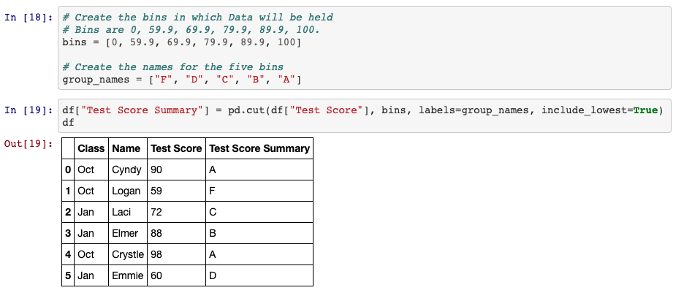
Binning Data: pd.cut()
Use pd.cut() when you need to segment and sort data values into bins. This function is also useful for going from a continuous variable to a categorical variable.

Slide 14
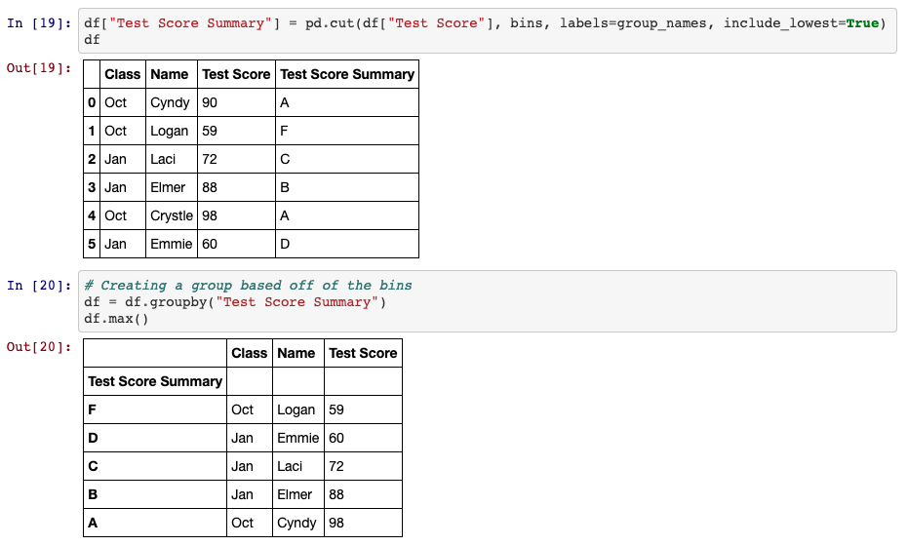
Binning Data
Binning is so powerful because, after creating and applying these bins, we can group the DataFrame according to those values, and then conduct a higher-level analysis.

Slide 15
Activity: Binning Movies
In this activity, you will test your binning skills by creating bins for movies based on their IMDb user vote count.
25 minutes

Slide 16
Activity: Binning Movies
Instructions | Read in the CSV file provided, and print it to the screen.
 | Find the minimum "IMDB user vote count" and maximum "IMDB user vote count".
 | Using the minimum and maximum "votes" as a reference, create 9 bins to slice the data into.
 | Create a new column called "IMDB User Votes Group", and fill it with the values collected through your slicing.
 | Group the DataFrame based on the values within "IMDB User Votes Group".
 | Find out how many rows fall into each group before finding the averages for "RottenTomatoes", "RottenTomatoes_User", "Metacritic", "Metacritic_User", and "IMDB".

Slide 17
Notes:
2.3
Check lesson plan to review! Or see below:
Open up 04-Stu_TedTalks within Jupyter Notebook and run through the code with the class, discussing it cell-by-cell.
Since the values contained within the "views" column are so widespread, there are several ways in which to split up the data that would be acceptable. This particular code uses a variable scale that attempts to look at every 200k view difference until reaching the millions, at which point it switches to look at every 1mil difference.
The bins are added into the DataFrame by simply placing them within a new column. The DataFrame is then grouped on this new column in order to perform all of the Data Functions.

Slide 18
Mapping

Slide 19
Similar to Excel’s number formats, Pandas unlocks the same functionality by using the df.map() method, which allows users to style entire columns at once.

Slide 20
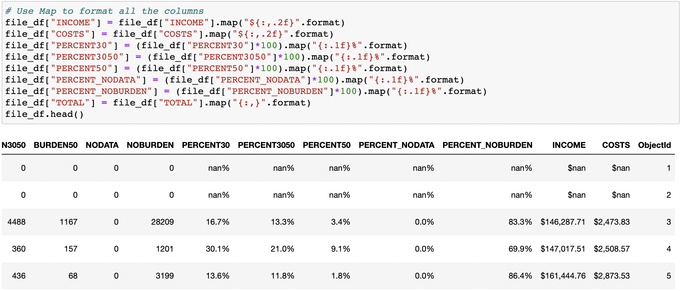
Mapping
df[<COLUMN>].map(<FORMAT STRING>.format) enables users to modify the styling of an entire column.
To convert values into a typical dollar format, use "${:.2f}". This places a dollar sign before the value, which has been rounded to two decimal places.
Using "{:,}" will split a number up so that it uses comma notation.

Slide 21
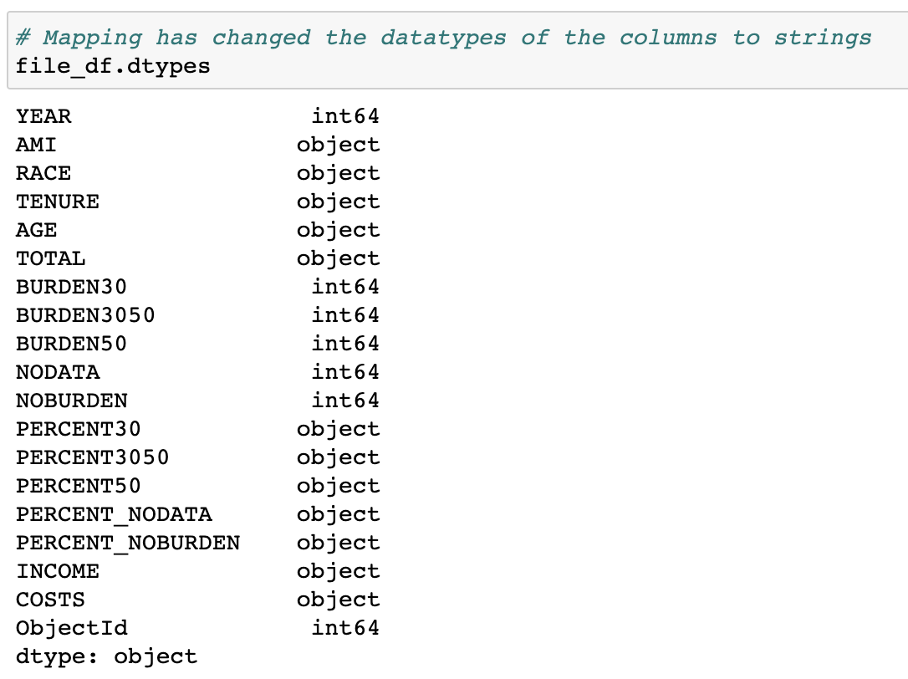
Mapping
Format mapping only really works once. It will return errors if the same code is run multiple times without restarting the kernel. Therefore, formatting is usually applied near the end of an application.
It will also format NaN values, so it is a good idea to run a .fillna() or .dropna() to avoid formatting null values.
Format mapping also can change the data type of a column, so all calculations should be handled before modifying the formatting.

Slide 22
Activity: Cleaning Crowdfunding
In this activity, you will take a dataset similar to your first homework, clean it up, and format it.
30 minutes

Slide 23
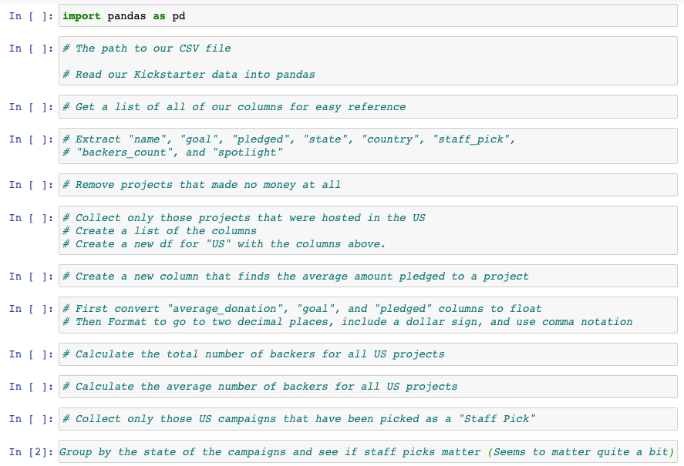
Activity: Cleaning Crowdfunding
The instructions for this activity are contained within the Jupyter Notebook.
Notes:
3.2
Open up the solved version of 06-Stu_CleaningKickstarter within Jupyter Notebook in order to show students what the final version of their application should look like.

Slide 24
Notes:
3.3
Check lesson plan to review! Or see below:
⏰3-Hour Adjustment: This review activity is now an Everyone Do.
Spend only 30 minutes on this activity.
Use the review section as guidance for talking points as you live-code along with the students.
Be sure to take your time and answer all student questions along the way.
Open up 06-Stu_CleaningKickstarter within Jupyter Notebook and run through the code with the class, discussing it cell-by-cell.

Slide 25
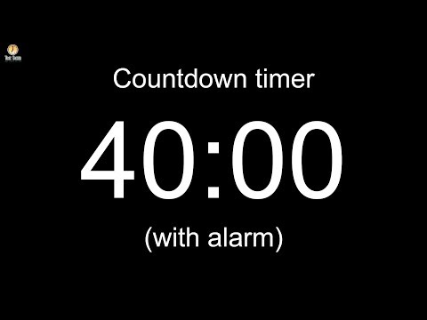
Notes:
Leave slide running during the break!
NOTE : In case needed due to the hour adjustment, fast forward the video timer and start the countdown at 25 minutes!
Image source: AdobeStock_56885471

Slide 26
Introduction to Bug Fixing

Slide 27
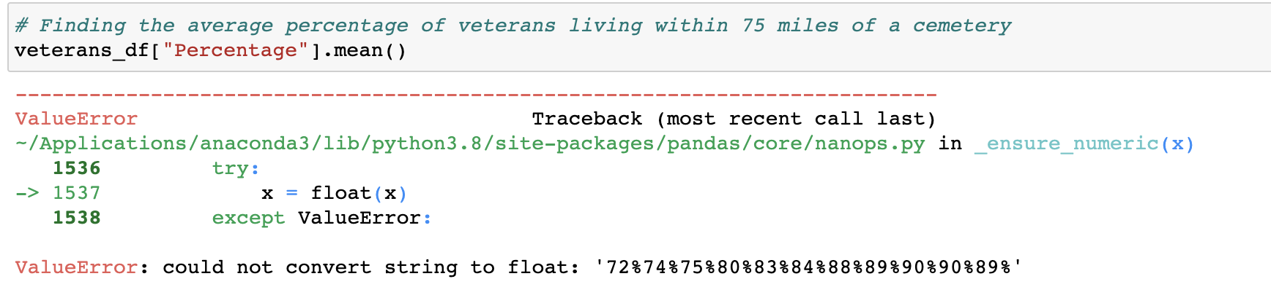
Bug-Fixing Bonanza
An error is returned as the application attempts to collect the average value within the Percentage column.
Notes:
4.1
Open up 07-Ins_IntroToBugfixing within Jupyter Notebook and slack the code out to the class as well. Make certain to send flavors_of_cacao.csv out to the class as well.
Point out to the class how, within the third block of code, an error is being returned as the application attempts to collect the average value within the "Cocoa Percent" column.
Many within the class likely already know what the bug within this block of code is - the values within the column are strings and it is not possible to collect the mean of a string - but tell them to hold off on pointing this out for now.

Slide 28
Bug-Fixing Bonanza
The first step: Keep calm.
Bugs happen all the time, and they are rarely the end of the world. In fact, most bugs that you’ll encounter are simple enough to solve as long as you know how and where to look for the solution.

Slide 29
Bug-Fixing Bonanza
The second step: Figure out what the bug is and where it’s located.
Jupyter Notebook makes it easy to find the erroneous block of code because the error will always be returned in the space following the erroneous cell.
Unfortunately, Pandas is not known for returning clearly understandable error text. In fact, it often returns large blocks of text that can easily confuse those who do not know the library's underlying code. The line following KeyError: is generally a good starting point.
For example, the text following ValueError: within the current code lets the programmer know that Pandas cannot convert the string values in the Percentage column to floats.
If the error text isn’t entirely clear, it can be helpful to print out variables/columns to the console to uncover the bug’s location. For example, printing out the Percentage series lets the programmer know that the data type of this Series is an object and not a float.
ValueError: could not convert string to float:
Notes:
4.1
The second step to bugfixing an application is to figure out what the bug is and where it is located.
Since the class is using Jupyter Notebook at this point in time, it is quite easy to find the erroneous block of code since the error will always be returned in the space beneath the erroneous cell.
Unfortunately Pandas is not known for returning clearly understandable error text. In fact, it often returns large blocks of text that is complex and confusing to those who do not know the library's underlying code. Looking for the line following KeyError: is generally a good starting point.
For example, the text following TypeError: within the current code lets the programmer know that Pandas cannot convert the string values in the "Cocoa Percent" column to floats.
If the error text is not entirely clear, it is oftentimes helpful to print out variables/columns to the console in order to uncover where the bug is. For example, printing out the "Cocoa Percent" series lets the programmer know that the dtype of this series is an object and not a float.

Slide 30

Bug-Fixing Bonanza
The third step: Research the error online to find solutions.
The key part to this step is coming up with an accurate way to describe the bug, which can take multiple attempts, but it is a skill that will develop over time.
Google is the programmer's best friend, as typing in a description of the bug will often bring up links to possible solutions. If not, simply alter the search a bit until a solution is discovered.
This particular problem requires the code to drop the percentages within the Percentage column, so the search could be more specific and add that information.
Pandas cannot convert string to float
Pandas cannot convert string to float percentages

Slide 31
Activity: Bug-Fixing Bonanza
In this activity, you will be provided with a Pandas project containing TONS of bugs. Your job is to take the application and fix it up so that it works properly.
35 minutes
Notes:
4.2

Slide 32
Activity: Bug-Fixing Bonanza
Instructions | Search the provided Jupyter notebook, and attempt to fix as many bugs as possible. There are a lot, and the bugs get harder to resolve as the code progresses.
 | Once you have finished bug fixing, perform some additional analysis on the provided dataset. What interesting theories and/or conclusions can you draw about bedbugs in New York City? As long as you challenge yourself, bugs will pop up and you’ll get more bug-fixing practice.
Hints | After fixing the bugs in each block of code, make sure to run the cell below for an updated error.
 | A few new concepts are covered within this Jupyter notebook. The most complex of these concepts is multi-indexing, and it is very likely that this is where many will get held up. Don’t worry: Multi-indexing is not in the homework, and it is not required outside of this activity. It is simply an interesting, powerful feature of Pandas.

Slide 33
Notes:
4.3
Check lesson plan to review! Or see below:
⏰3-Hour Adjustment: This review activity is now an Everyone Do.
Spend only 28 minutes on this activity.
Use the review section as guidance for talking points as you live-code along with the students.
Be sure to take your time and answer all student questions along the way.
Open up 08-Stu_BugfixingBonanza within Jupyter Notebook and run through the code with the class, discussing it cell-by-cell.
Whoever wrote this code originally is not very good at their job... But it is a sad fact of life that many programmers out there are not exceptionally good at crafting clean code. As such, it is extremely helpful to practice bugfixing as much as possible.
The first bug is rather simple. No dependencies have been declared and, as such, the application will not be able to use Pandas.
The second bug is also pretty simple. The CSV is being read in but it is not being saved to a DataFrame.
The third bug is where things start getting complex. For whatever reason, Pandas does not seem to be able to collect data from the "Number of Comments" column. This is because the column header includes new lines inside of it. The columns will need to be renamed to fix this.
The fourth/fifth bugs are another step up in difficulty as the assignee_group DataFrame has two indexes. The first is the "Assignee" and the second is the "Component". While this makes for a nicely organized DataFrame, it creates problems later on.
In order to collect the correct values for total_bugs, the application must count the "Assignee" column of the initial DataFrame while bugs_per_user should count the "Assignee" column of the GroupBy object. The series should then be converted into a DataFrame for merging later on.
It is not possible to merge DataFrames on indexes. As such, both of the DataFrames need to have their indexes reset so that it is possible to merge on the "Assignee" column. If this is not done, incorrect data will be used, an error will be returned, or only some rows will be filled.

